Slide 1
Neuroinflammation in airway diseases
Developed in collaboration with Professor Harald Renz

Slide 2
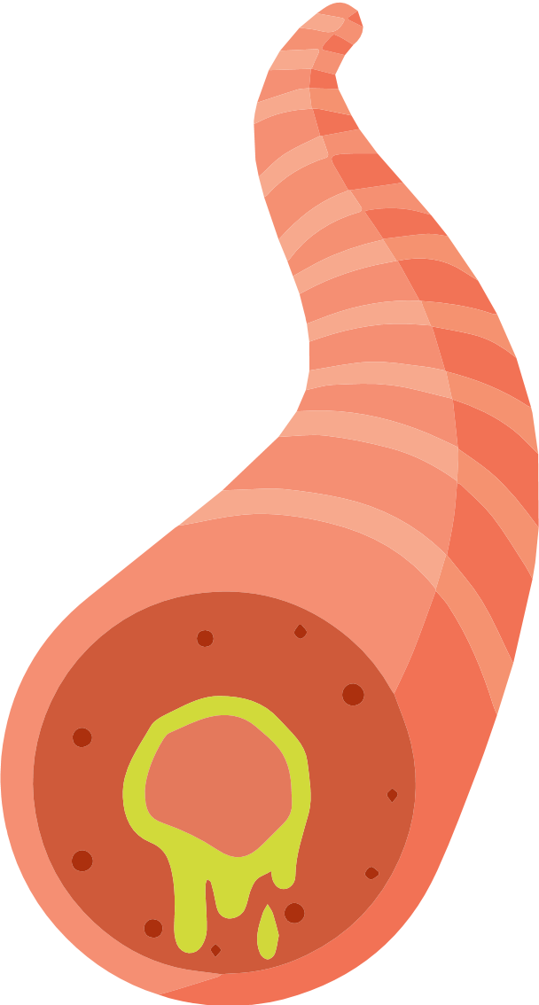
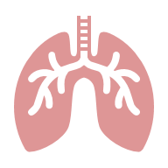
How are the airways innervated?
The airways are innervated by a dense network of parasympathetic, sympathetic and sensory nerves^{1,2}
Airway innervation is required to regulate breathing, and drive bronchoconstriction and mucus secretion²
Airway innervation also provides the basis for the initiation of defence mechanisms in response to viral and bacterial infections and environmental irritants²
Overview of airway innervation²
Cholinergic postganglionic neurons
Nodose neurons
Jugular ganglion
Jugular neurons
Nodose ganglion
Medulla oblongata/ brainstem
Dorsal root ganglion neuron
Vagus nerve (efferent port)
Vagus nerve (afferent port)
Noncholinergic postganglionic neurons
Dorsal root ganglion
Oesophagus
Spinal cord
Figure is adapted from Nassenstein et al. 2018
Lung

Slide 3


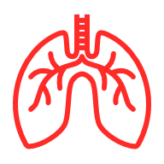



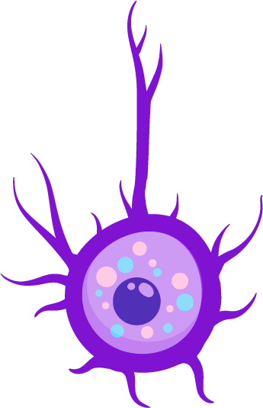
The nervous system functions in a regulatory feedback loop^{1,2}
This loop exists between the brain and other organs (e.g., lungs, gut, skin), and maintains homeostasis by constantly monitoring and adjusting to changes^{1–3}
Neural feedback loop^{1,2,4}
Neural feedback loop in the airways^{1–6}
Stimulus
Inhaled irritant (e.g., smoke)
Response
Sensor (receptor)
ASM contraction and mucus secretion, limiting further irritant exposure
Irritant receptors and rapidly adapting receptors in the epithelium
Effector (muscles/glands)
Control centre (CNS)
Parasympathetic efferents induce ACh release
Sensory afferents send signal to the brainstem

Slide 4

In the lungs, the nervous system mediates irritant detection, cough, bronchoconstriction and breathing^{1,2}
The nervous system and neuro-immune interactions play an important role in driving or modulating the physiopathology of airway diseases²
The airway epithelium anatomically and functionally collaborates with the nervous system³
Airway inflammatory mediators and irritants can stimulate nerves, leading to neurogenic inflammation³
The nervous system can also play a role in driving other inflammatory diseases (e.g., rheumatoid arthritis, systemic lupus erythematosus and systemic sclerosis)⁴
In inflammatory airway diseases, such as asthma, the neural feedback loop is amplified in response to repeated exposure to triggers^{1,5–8}
Leading to pathological features, e.g., airway hyperresponsiveness and exaggerated inflammatory response

Slide 5




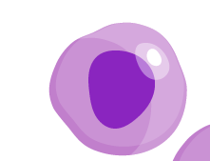


In asthma the regulatory neural loop drives the recruitment of immune cells^{1–3}
Neuroimmune interaction requires proximity between immune cells and neurons¹
The lungs are densely innervated by the somatosensory and the autonomic nervous system, which have nerves that terminate in the epithelium^{2,5}
Sensory neurons detect inflammatory mediators, including neurotrophins and histamine, released from mast cells in an allergic early-phase reaction¹
T2 alarmins produced by the epithelium (e.g., IL-33, TSLP) can also stimulate sensory neurons¹
Parasympathetic ganglia and postganglionic neurons are located in the airways, and immune cells can trigger ACh release¹
Neural innervation of the airways^{1–4}
Parasympathetic innervation
Sympathetic innervation
Somatosensory innervation
Immune cells
Goblet cell
Tuft cell
Ciliated cell
Smooth muscle

Slide 6
IL-33 and TSLP may drive asthma pathophysiology through interaction with sensory neurons¹
TSLP, IL-25 and IL-33 are epithelial cytokines released by activated epithelial cells in response to injury or environmental insult^{2,3}
IL-33
TSLP
IL-33 can stimulate sensory neurons directly through ST2 expressed in small-diameter sensory neurons¹
This IL-33/ST2 axis has been shown to drive inflammation and pathophysiology in asthma
Outside of the lungs, IL-33 has been shown to directly activate peripheral sensory neurons via ST2^{4,5}
In the skin, TSLP has been shown to activate a subset of TRPV1⁺ and TRPA1⁺ sensory neurons^{1,6}
TSLP binds to its receptor on the neuron, activating phospholipase C signalling, which couples MrgprC11 to TRPA1, and Gβγ signalling, which couples MrgprA3 to TRPA1. Both exciting the neuron
TRPA1 activation promotes lung inflammation in mouse models of airway inflammation and asthma and also impacts skin, airways and gastrointestinal tract ⁶
Elevated epithelial TSLP in asthma is associated with airway inflammation and AHR⁷

Slide 7
Acute triggers and chronic inflammation drive different short- and long-term neural responses in the lung^{1–7}
Short-term^{1–4}
Long-term^{3–7}
Airway epithelial, immune and structural cells produce the neurotrophins NGF and BDNF⁶
Patients with asthma have higher baseline levels of expression^{1,4}
NGF and BDNF act as bridges between inflammation and neuronal sensitisation, amplifying airway responses^{1,6}
Sustained NGF and BDNF levels in asthma lead to increased nerve length and branching and persistent AHR^{4,7,8}
Acute trigger
Epithelial/immune cell neurotrophin release
Neuron activation and response
Chronic inflammation
Sustained neurotrophin elevation
Nerve growth/remodelling, enhancing long-term airway responsiveness

Slide 8
Summary
Airway innervation modulates breathing and the physiopathology of airway diseases^{1–3}
The nervous system functions in a regulatory feedback loop between the brain and other organs, including the lungs^{1,4,5}
This feedback loop is amplified in asthma in response to triggers, leading to ASM contraction and mucus secretion^{1,2,4,6,7}
In asthma, the regulatory neural loop drives the recruitment of immune cells and the production of epithelial cytokines, such as IL-25, IL-33 and TSLP^{1,3,8}
These epithelial cytokines stimulate sensory neurons to drive asthma pathophysiology, such as inflammation and AHR^{3,9,10}
Acute triggers and long-term inflammation can result in differing neural responses in the lungs^{11–17}
In both scenarios, airway epithelial, immune and structural cells produce the neurotrophins NGF and BDNF, which are drivers of increased nerve length and branching and persistent AHR in asthma^{11,15,17,18}

